Slide 1
Physics models & machine learning for microelectronics reliability
Alejandro Strachan
Date: July 15, 2019
Microelectronics Integrity Meeting (MIM) , August 6-7, 2019 Indianapolis

Slide 2
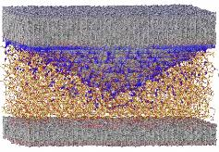
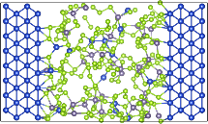
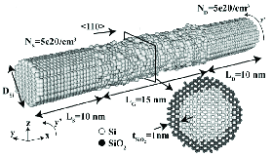
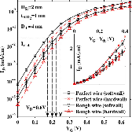
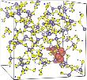
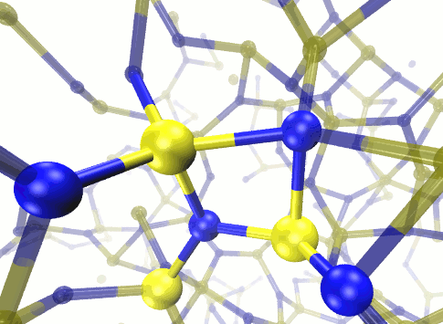
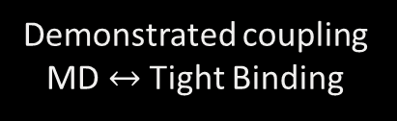
Device & materials modeling
… from first principles
Molecular dynamics
ASSURE
Device reliability
Radiation damage
Million Atoms=>
Devices=>TCAD
Recent breakthrough
MD → TB
Demonstrated coupling MD $↔$ Tight Binding
Density functional theory
Materials Science
Device engineering

Slide 3
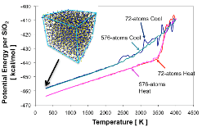


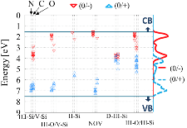
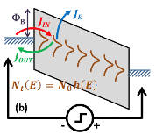
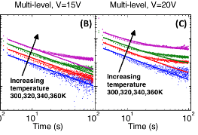




From atoms to devices
MD: amorphous structures
DFT defect energy levels
Mesoscale charging model
Current transients
Resistive switching devices
Electric double layers
Phase change materials

Slide 4
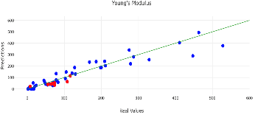
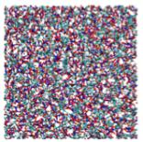
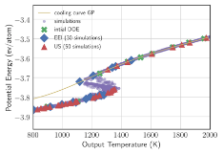
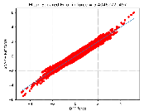
Machine learning & device models
Learn from data, by example, without (or with little) underlying physics/chemistry information
ML models of Mat/Dev Props
Dimensionality reduction in multiscale modeling
Design of experiments / optimization
Interatomic potentials via machine learning

Slide 5


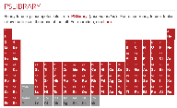




Machine learning & device models
Materials & devices specific challenges
We do not have lots of data & data acquisition can be costly
  …but we have physics
Uncertainties in input data with disparate origins
High consequence decisions (?) and regulated sectors
We like to understand to have confidence in predictions
Develop and sustain open cyberinfrastructure for data & models

Slide 6
Phase change materials
Flash heating
(200 ps)
Can non-equilibrium loading of the PCM
Reduce timescales required for melting/amorphization?
Achieve states not available via equilibrium thermodynamics?

Slide 7
Non-equilibrium states
200 ps
Flash heating
Non-eq. flash
6,000 MD simulations (to explore 4 dimensions)

Slide 8
Sequential design of experiments
Can ML help reduce the number of experiments?
Dataset
DONE?
Update dataset
State of knowledge
Query information source
Information acquisition function
Pandita P, Bilionis I, Panchal J. Journal of Mechanical Design. 2016 138, 111412.

Slide 9
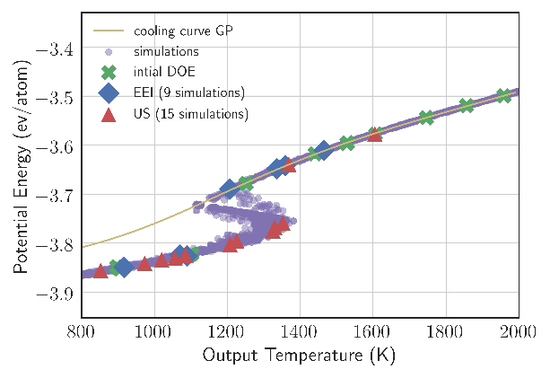
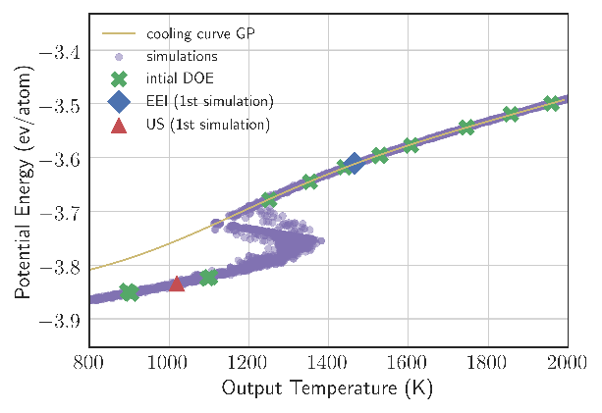
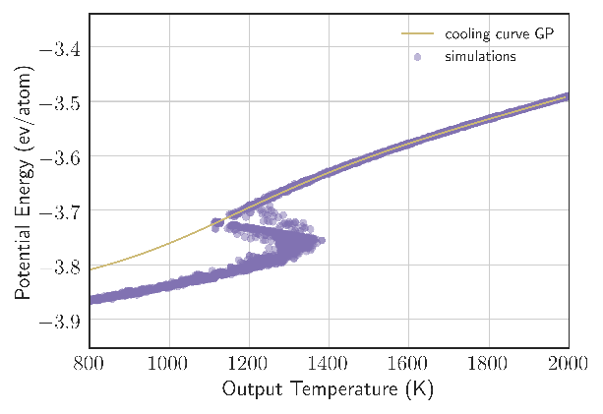
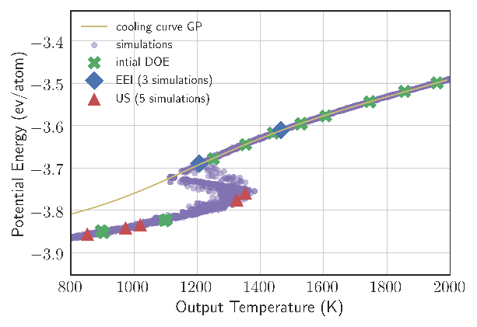
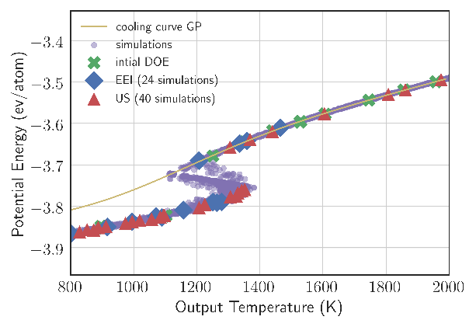
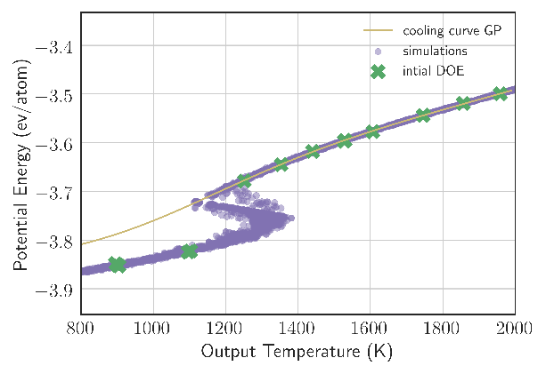
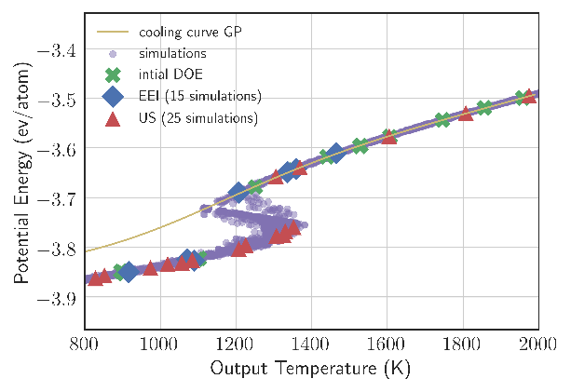
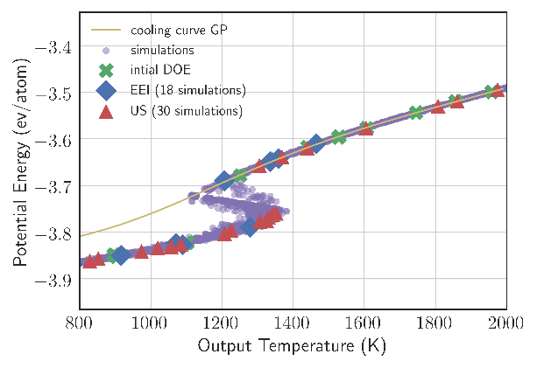
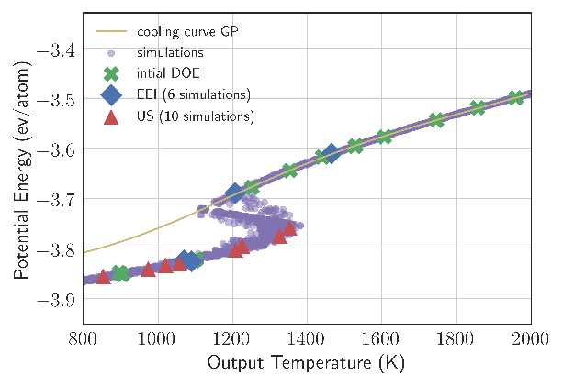

Comparing information acquisition functions
Collaboration with Prof. Bilionis, Purdue

